Slide 1
SleepNet: Automated sleep analysis via dense convolutional neural network using Physiological time series
B Pourbabaee1 , M H Patterson2 , M R Patterson3 and F Benard4
February 2019
Paul Okafor
March 12th, 2024

Slide 2

Introduction
Good Sleep = Good Health
Vital for maintaining overall health.
Lack of quality sleep linked to various health issues: depression, obesity, cardiovascular diseases
Common Sleep Disorders
Apnea: Stopping breathing during sleep that lasts for more than 10 seconds.
Hypopnea: Very shallow breathing during sleep.

Slide 3
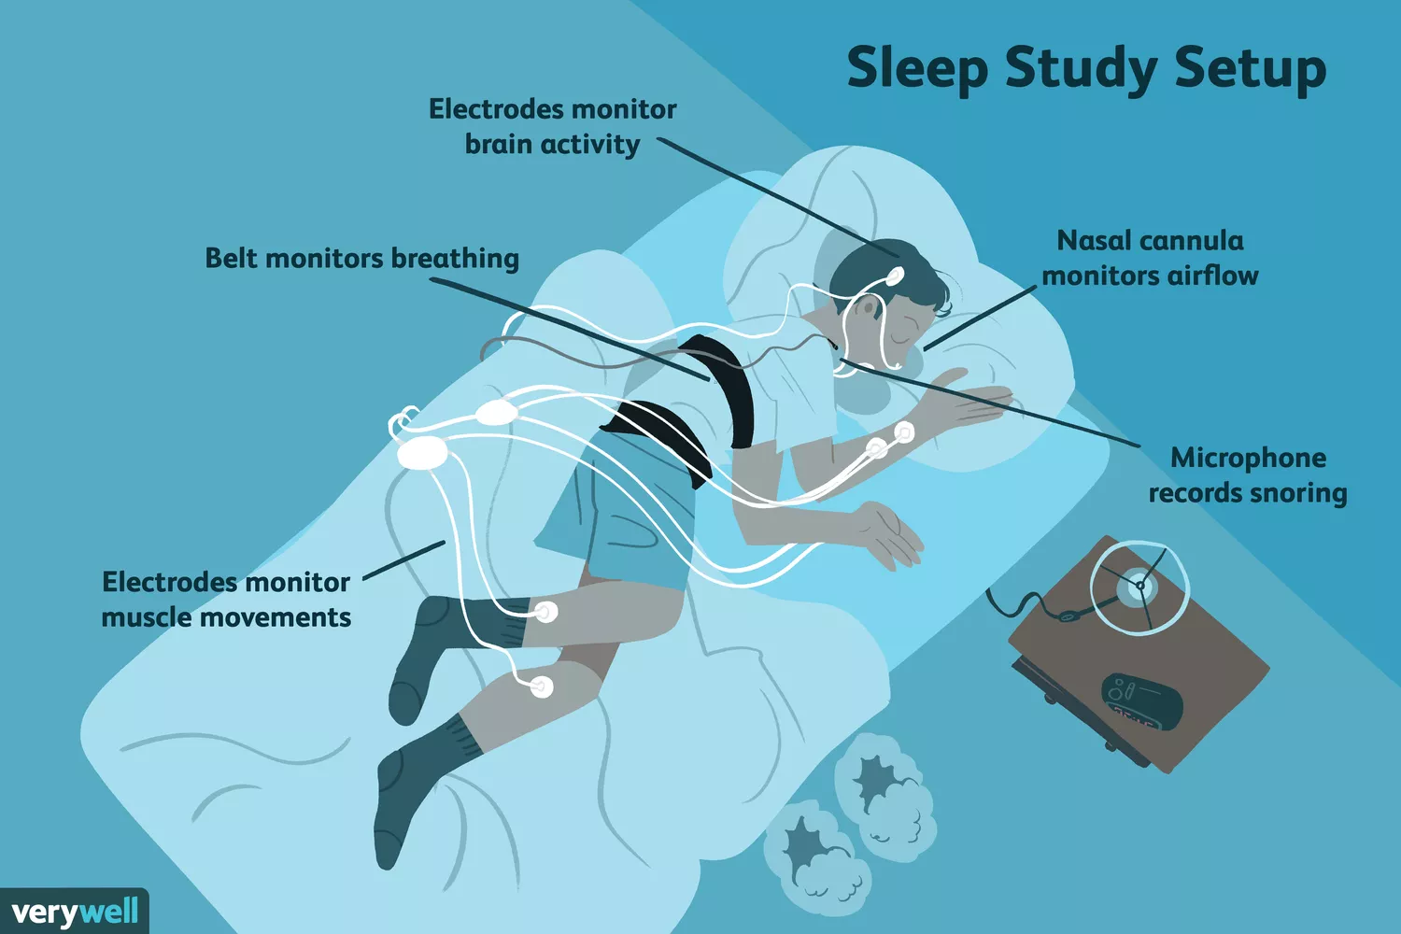
Introduction
Detecting Sleep Problems
Polysomnography (PSG): The gold standard sleep study. tracking multiple physiological signals during sleep.
What does Polysomnography measure:
Brainwave activity and sleep stages
Heart rhythm
Muscle tone
Leg movements
Breathing patterns
Blood oxygen levels
Notes:
A sleep study, called a polysomnogram, is a test used to help diagnose sleep apnea, restless legs syndrome (RLS), and other sleep disorders. People usually spend the night at a hospital sleep laboratory or an outpatient sleep clinic. Electrodes attached to their body monitor their brain waves, breathing, and movement while they sleep.

Slide 4
Introduction
Research Problem
Poor sleep linked to major health issues.
Current methods for detecting disruptions are manual and costly (like the PSG)
Challenges in identifying less common sleep disturbances like non-apnea/hypopnea arousals (teeth grinding, leg movements, pain or discomfort, noise).
Research Objectives:
Develop SleepNet: Create an automated system using a dense recurrent convolutional neural network for analyzing sleep disorders.
Innovative Approach: Utilize a multi-task learning framework within the network to improve detection of arousal regions, apnea/hypopnea, and sleep/wake intervals.
Notes:
Non-apnea/hypopnea arousals are sleep disruptions that cause a person to transition from a deeper stage of sleep to a lighter one or even to wakefulness, without being associated with apnea (complete cessation of breathing) or hypopnea (significant reduction in breathing). These arousals can be caused by various factors other than breathing difficulties, such as:
Respiratory Effort Related Arousals (RERAs): These are episodes where there is increased breathing effort due to partial airway obstruction, but they don't meet the criteria for apnea or hypopnea.
Teeth Grinding (Bruxism): This can cause brief awakenings or transitions to lighter sleep stages.
Muscle Jerks or Limb Movements: Sudden involuntary muscle contractions can disrupt sleep.
Pain or Discomfort: Can lead to arousal from sleep without being linked to breathing problems.
Noise or Environmental Factors: External disturbances can also cause a person to briefly wake up or shift to a lighter sleep stage.

Slide 5
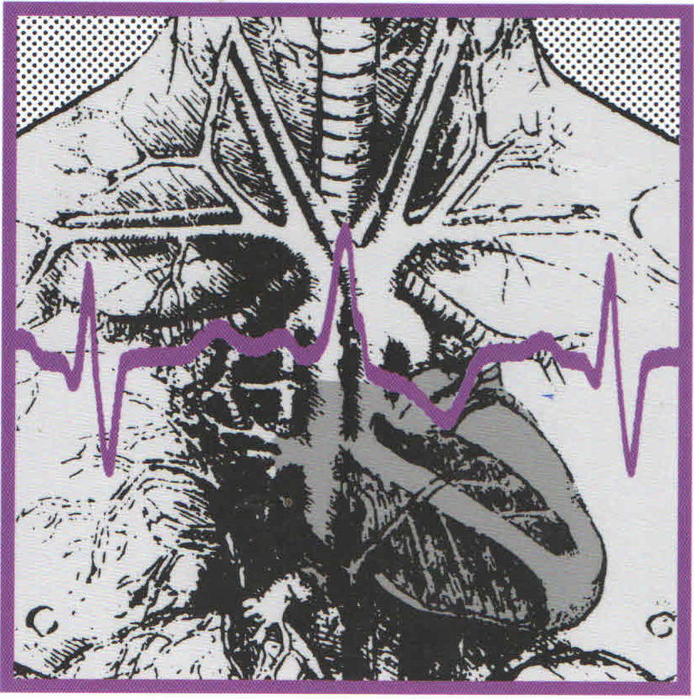
Dataset Overview
Source: Massachusetts General Hospital (MGH)
Subjects: 1,985 patients (Train = 994, Test = 989)
Recorded Signals:
Brain waves (EEG), Eye movements (EOG), Muscle activity (EMG) etc. (sampled at 200 Hz, measured in microvolts) etc.
Oxygen Saturation (SaO2) (resampled to 200 Hz, measured as a percentage)
Annotations:
Sleep Stages: Wakefulness, Stage 1, Stage 2, Stage 3, REM, Undefined (annotated in 30-second intervals)
Arousal Annotations: Spontaneous, Respiratory Effort Related (RERA), Bruxisms, Hypopneas, Apneas (Central, Obstructive, Mixed), Snores, Periodic Leg Movements etc.
Notes:
Sleep Stages:
Wakefulness: The state of being awake and aware of the surroundings. It's characterized by beta and alpha brain waves, which indicate an alert and active mind.
Stage 1: The initial stage of sleep, often considered the transition phase between wakefulness and sleep. It's marked by theta waves and is a light sleep stage from which people can be easily awakened.
Stage 2: A deeper stage of sleep characterized by sleep spindles and K-complexes. During this stage, heart rate and breathing stabilize, and body temperature drops. It's a period of light sleep before entering deeper sleep stages.
Stage 3: Often referred to as deep sleep or slow-wave sleep, this stage is characterized by delta waves. It's the most restorative sleep stage, during which the body repairs and regrows tissues, builds bone and muscle, and strengthens the immune system.
REM (Rapid Eye Movement): This stage is associated with vivid dreams due to increased brain activity. It's characterized by rapid eye movements, increased heart rate and blood pressure, and temporary paralysis of the limb muscles. REM sleep is crucial for cognitive functions like memory and learning.
Undefined: Intervals that cannot be clearly classified into any of the above sleep stages, often due to data quality issues or ambiguous physiological signals.
Arousal Annotations:
Spontaneous: Arousals that occur without an apparent external stimulus or specific physiological cause.
Respiratory Effort Related Arousal (RERA): A sequence of breaths characterized by increasing respiratory effort leading to arousal from sleep, but not meeting the criteria for apneas or hypopneas.
Bruxisms: Involuntary grinding or clenching of the teeth during sleep, which can lead to arousals.
Hypopneas: Episodes of overly shallow breathing or an abnormally low respiratory rate, leading to a decrease in blood oxygen levels and potential arousals.
Apneas: Episodes where breathing stops or is significantly reduced due to blockage of the upper airway (Obstructive), lack of respiratory effort (Central), or a combination of both (Mixed), often resulting in arousal from sleep to resume breathing.
Snores: Noisy breathing during sleep, which can indicate partial obstruction of the upper airway and lead to sleep disruptions or arousals.
Periodic Leg Movements: Repetitive cramping or jerking of the legs during sleep that can cause sleep fragmentation and arousals.

Slide 6
Methodology and Model Design

Slide 7
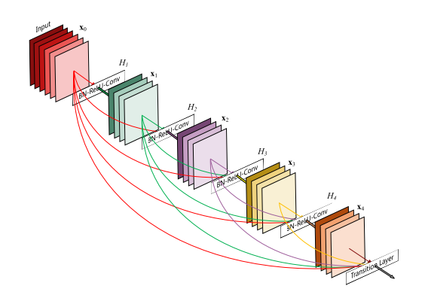
Methodology
Network Architecture
Base: Dense Recurrent Convolutional Neural Network (DRCNN), an extension of DenseNet.
DCUs: Multiple Dense Convolutional Units ensure deep feature learning through interconnected layers.
Bidirectional LSTM: Enhances temporal data analysis, crucial for sleep event dynamics.
Residual Skip Connection: Preserves information across layers, improving learning efficiency.
Notes:
DenseNet, short for Densely Connected Convolutional Networks, introduces a unique architecture where each layer is directly connected to every other layer in a feed-forward fashion. Unlike traditional CNNs where each layer only receives input from the previous layer, in DenseNet, a layer receives inputs from all preceding layers. This connectivity pattern is termed as "dense connectivity.“
In ResNets, skip connections are used to bypass one or more layers by adding the input of a block to its output. This facilitates a direct gradient flow through these connections, making it easier to train deeper networks.
A Bidirectional Long Short-Term Memory (Bi-LSTM) is an extension of the traditional LSTM neural network, designed to improve model performance by providing additional context to the network. While a standard LSTM processes data sequentially from the beginning to the end, a Bi-LSTM processes data in both forward and backward directions.
What's unique about DenseNet is that it efficiently addresses the vanishing gradient problem and strengthens feature propagation through the network. The dense connectivity ensures maximum information flow between layers, making the network more efficient and reducing the number of parameters.
DenseNet also incorporates features similar to ResNets (Residual Networks) by using skip connections. However, instead of adding the output of previous layers (as in ResNets), DenseNet concatenates feature maps from all preceding layers. This approach provides a more diverse set of features for each layer, improving the model's representational capability.
Key advantages include:
Improved information flow and feature reuse, leading to more efficient training.
Reduction in the vanishing gradient problem, as gradients can flow directly through the skip connections.
Compact models with fewer parameters, as feature reuse diminishes the need for learning redundant features.

Slide 8
Methodology
Learning Mechanism
Multi-Task Learning: Employs primary (arousal detection) and auxiliary tasks (apnea-hypopnea/normal breathing, sleep/wake intervals) to improve generalization.
Labeling & Remapping: Uses a labeling system to categorize sleep events, with a remapping mechanism to simplify output interpretation.
Training Process: Employs a cross-validation approach, using 100 full-night recordings per epoch
Performance Metrics: Utilizes AUPRC and AUROC to gauge model accuracy
Notes:
In the context of sleep studies, an "arousal" refers to a brief period of wakefulness or heightened brain activity during sleep. This can disrupt the sleep cycle, moving the sleeper from a deeper sleep stage to a lighter one or even to wakefulness

Slide 9
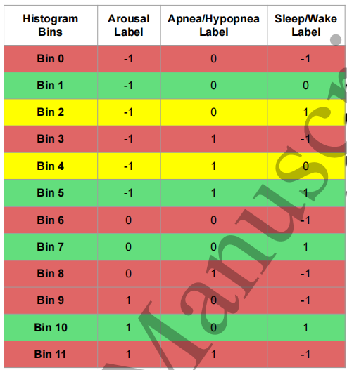
Data Pre-processing
Labelling and Bins for Detection Tasks
Target Arousal Detection:
Target arousal: 1
Non-target arousal (apnea/hypopnea or wake): -1
Normal: 0
Apnea-Hypopnea/Normal Detection:
Apnea/hypopnea: 1
Normal: 0
Sleep/Wake Detection:
Sleep (REM, NREM stages): 1
Wake: 0
Undefined: -1
Notes:
REM (Rapid Eye Movement) and NREM (Non-Rapid Eye Movement) are stages of sleep that each have distinct characteristics:
NREM Sleep: This is divided into three stages, NREM1, NREM2, and NREM3, each progressively deeper than the last.
NREM1: This is the lightest stage of sleep, often considered the transition phase between wakefulness and sleep. It's characterized by slow eye movements, reduced muscle activity, and the ability to be easily awakened. People in this stage might experience sudden muscle contractions known as hypnic jerks.
NREM2: This stage accounts for the majority of our sleep time. It is deeper than NREM1 and features specific patterns on an EEG, including sleep spindles and K-complexes. There are no eye movements, and heart rate and breathing slow down.
NREM3: Often referred to as deep sleep or slow-wave sleep, NREM3 is the deepest stage of NREM sleep. It's characterized by delta waves on an EEG, slow breathing, and reduced heart rate and muscle activity. Waking someone from this stage can be difficult, and if awakened, a person might feel disoriented for a few minutes.
REM Sleep: This stage is known for rapid eye movements, increased brain activity, and vivid dreams. It's characterized by paralysis of most voluntary muscles (REM atonia), preventing people from acting out their dreams. REM sleep typically begins around 90 minutes after falling asleep and recurs about every 90 minutes, getting longer later in the night.

Slide 10

Data Pre-processing
Channels Used: Excludes brain waves (ECG), focusing on 12 PSG channels for sleep scoring.
Preprocessing Steps:
Anti-aliasing FIR filter applied to reduce noise and prevent aliasing.
Signals downsampled to 50 Hz and DC bias removed for signal centering.
Normalization conducted on an 18-minute moving window per channel, using mean subtraction and division by RMS value, employing FFT convolution for efficiency.
Oxygen saturation (SaO2) scaled to a specific range to prevent neural network overload.
Notes:
Preprocessing Steps:
Anti-aliasing FIR filter: This is a type of digital filter applied to the signals to reduce noise and prevent aliasing. Aliasing is a phenomenon that can cause different signals to become indistinguishable (or "aliases" of one another) when sampled, leading to inaccuracies in signal representation. The filter helps in maintaining the integrity of the signals by removing high-frequency content that could cause aliasing.
Downsampling to 50 Hz: The original signals, which might have been recorded at a higher sampling rate, are reduced to a sampling rate of 50 Hz. This means that the signals are now represented with 50 data points per second, which is sufficient for capturing sleep-related information and reduces the computational load for processing.
DC bias removal: This step involves adjusting the signal so that its mean value is centered around zero. DC bias is a constant offset value that can skew the signal away from zero. Removing it ensures that the signal oscillations are centered around zero, making further analysis more straightforward.
Normalization: Each channel's signal is normalized independently using an 18-minute moving window. In this context, "normalizing" means adjusting the signal so that its fluctuations are within a standard range, which makes different signals more comparable and easier to analyze. They subtract the mean and divide by the root-mean-square (RMS) value within the window. RMS is a statistical measure of the magnitude of a varying quantity and here it helps in scaling the signal amplitude. Fast Fourier Transform (FFT) convolution is a mathematical technique used to efficiently perform this normalization over each moving window.
Oxygen saturation (SaO2) scaling: The SaO2 signals, which measure the percentage of oxygen in the blood, are scaled to fit within a specific range. This is done to avoid large values that could potentially "overload" or saturate the neural network, making the learning process less effective.
FFT convolution refers to the use of the Fast Fourier Transform (FFT) in the convolution operation, primarily to enhance computational efficiency. Convolution, a fundamental operation in signal processing, involves the integration of two functions to produce a third function that expresses how the shape of one is modified by the other. It's widely used in digital signal processing for filtering, analyzing signals, and in deep learning for operations like image and signal transformations.

Slide 11
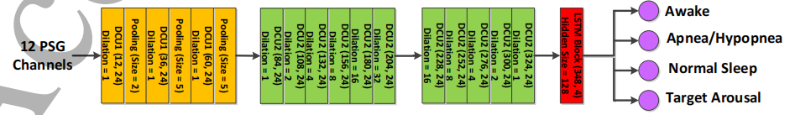
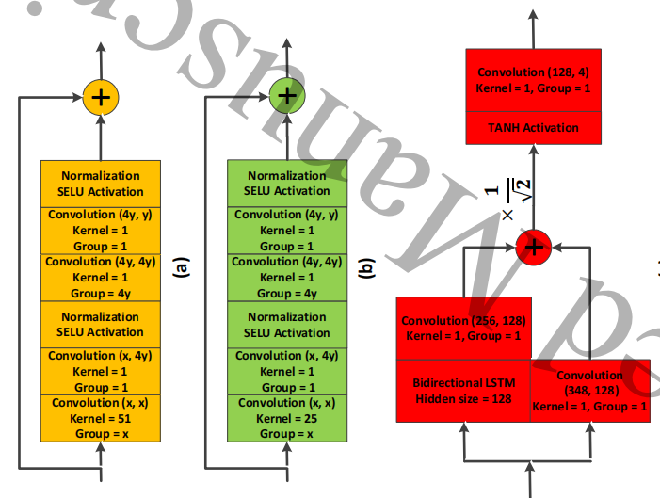
Sleep Disorder Detector Model
DCU1: Initial layers with max-pooling for downsampling signals from 50 Hz to 1 Hz.
DCU2: Features depthwise separable convolutions, SELU activations, weight, and position-wise normalization. Uses dilated convolutions to expand the receptive field.
LSTM Layer: Processes temporal data with a residual skip connection; additional convolutions adapt LSTM output for further analysis.
Loss Function: Weighted cross-entropy balancing primary and auxiliary tasks.
Optimization: Adam method, with checkpointing for best model configurations.
Notes:
SELU, which stands for Scaled Exponential Linear Unit, is an activation function introduced in neural networks to improve their training dynamics. The SELU function aims to induce self-normalizing properties in neural networks, particularly in deep feedforward architectures. This self-normalizing feature helps maintain a mean of zero and a standard deviation of one for the inputs to each layer throughout the network, reducing the vanishing or exploding gradient problems and improving the convergence during training.

Slide 12
Results

Slide 13
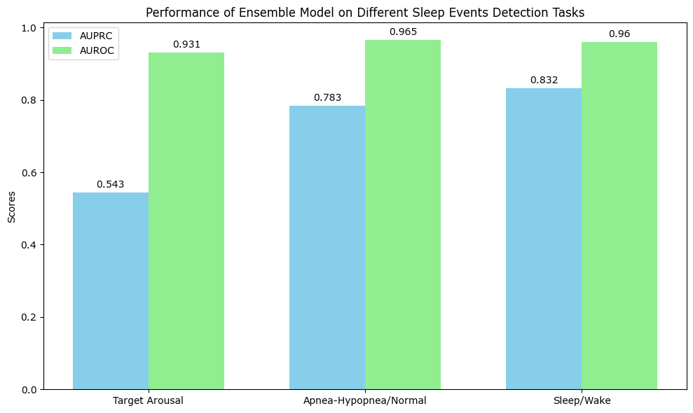
Empirical Results
Target Arousal Detection: High precision with AUPRC at 0.543 and strong discrimination capability with AUROC at 0.931.
Apnea-Hypopnea Identification: Excellent accuracy in distinguishing events with AUPRC at 0.783 and AUROC at 0.965.
Sleep/Wake State Classification: Reliable detection with AUPRC at 0.832 and AUROC at 0.960.
Notes:
High AUROC (close to 1) (Area Under the Receiver Operating Characteristic" curve): Indicates that the model has a high ability to discriminate between the positive and negative classes (true positive rates and false positive rates). It means the model can effectively distinguish between true positives (correctly predicted positives) and true negatives (correctly predicted negatives), regardless of the class distribution.
High AUPRC (close to 1): Precision-Recall curves are suitable for imbalanced datasets, as they focus on the performance of the positive class. Signifies that the model not only identifies positive cases effectively (high recall) but also ensures that the cases it predicts as positive are actually positive (high precision). This is particularly important in imbalanced datasets where positive cases are rare.

Slide 14

Study Findings
Multi-Task Learning: Enhanced detection of arousal regions and accurate identification of sleep disorders, indicating the DRCNN's instrumental role in sleep monitoring
Overestimation Preference: Model's overestimation of apnea-hypopnea severity seen as advantageous over underestimations, simplifying technician reviews.
Versatile Performance: While focused on arousal detection, the DRCNN also satisfactorily identified apnea/hypopnea events and sleep/wake states, suggesting broader applicability.
Notes:
Outliers were noted, but shared such a small portion of the data that they were not considered to have an impact on modeling.
Data mean-centered and scaled

Slide 15

Limitations
Comparison to Human Performance: The need for a direct comparison due to variability in human annotations and data annotated by a single scorer.
Dataset Generalizability: Single-site data limits model applicability; diverse datasets from multiple sites are necessary for broader validation.
Equipment Dependency: Model reliance on specific PSG channels could restrict use with different equipment or in varied clinical settings.
Notes:
Outliers were noted, but shared such a small portion of the data that they were not considered to have an impact on modeling.
Data mean-centered and scaled

Slide 16
Thank You

